Slide 1

Database Design & Programming
SQL Single-Row Functions
Chapter 10

Slide 2
Types of Functions
Function – predefined block of code that accepts arguments
Single-row function – returns one value for each row processed
Multiple-row function – returns one value per group of rows selected
Oracle 12c: SQL

Slide 3
Single Row Example
Show the first name and last name of all customers. Capitalize the first character of the first name and last name. Sort by last name and then first name.
select initcap(firstname), initcap(lastname)
from customers
order by 2, 1;

Slide 4
Group-Row Function
What is the average retail price of all books?
select avg(retail) "Average Price"
from books;

Slide 5
Types of Functions
Type of Function | Functions
Case Conversion Functions | UPPER, LOWER, INITCAP
Character Manipulation Functions | SUBSTR, INSTR, LENGTH, LPAD, RPAD, LTRIM, REPLACE, TRANSLATE, CONCAT, TO_CHAR
Numeric Functions | ROUND, TRUNC, MOD, ABS, POWER
Date Functions | MONTHS_BETWEEN, ADD_MONTHS, NEXT_DAY, LAST_DAY, TO_DATE, ROUND, TRUNC
Null Handling Functions | NVL, NVL2, NULLIF
Branching Functions | DECODE, CASE
Oracle 12c: SQL

Slide 6
Case Conversion Functions
Case conversion functions alter the case of data stored in a column or character string
Used in a SELECT clause, they alter the appearance of the data in the results
Used in a WHERE clause, they alter the value for comparison
Oracle 12c: SQL

Slide 7
LOWER Function
Used to convert characters to lowercase letters
Can be used to do case insensitive searches.
Find all customers whose last name matches ‘smith’, regardless of case.
select firstname, lastname
from customers
where lower(lastname) = 'smith';
Oracle 12c: SQL

Slide 8
UPPER Function
Used to convert characters to uppercase letters
It can be used in the same way as the LOWER function
To affect the display of characters, it is used in a SELECT clause
To modify the case of characters for a search condition, it is used in a WHERE clause
The syntax for the UPPER function is UPPER(c)
Where c is the character string or field to be converted into uppercase characters
Oracle 12c: SQL

Slide 9
INITCAP Function
Used to convert characters to mixed case, capitalizing the first character of each word.
Show all customers name and their address. Capitalize the start of each new word in the address.
select lastname, initcap(address)
from customers;
Oracle 12c: SQL

Slide 10
Character Manipulation Functions
Character manipulation functions manipulate data by extracting substrings, counting the number of characters, replacing strings, etc.
Oracle 12c: SQL

Slide 11
SUBSTR Function
Used to return a substring, or portion of a string
First the 3 digits of the US zip are related to the sectional center facility, the mail sorting and distribution centre for an area. Produce a list of all the section centers used by California and Florida customers. Sort by state and then US zip. Include the first name, last name, state, sectional center and ZIP in the report.
Oracle 12c: SQL

Slide 12
Sectional Centre Report
select firstname, lastname, state, substr(zip,1,3) "Sectional Centre", zip
from customers
where state in ('CA', 'FL')
order by state, zip;

Slide 13
INSTR Function
INSTR(a, b)
Returns the position of the first occurrence of string ‘b’ in string ‘a’
Returns 0 if not found
INSTR(a, b, start)
Returns the position of the first occurrence of string ‘b’ in string ‘a’ starting at position ‘start’
Unlike java, the first character is at position 1
Combined with SUBSTR() it can be used to strip out data out of complex fields.
Oracle 12c: SQL

Slide 14
Nesting Functions
Display all books and the year they were published. To get the month nameand extract it from the pubdate. Format of pubdate is: Month dd, yyyy
go from the beginning to the first space
Oracle 12c: SQL
Notes:
select title, to_char (pubdate, 'fmMonth dd, yyyy') "Pub Date"
from books;
column "Pub Date" FORMAT A30
column "Month" FORMAT A15
SELECT title, to_char (pubdate, 'fmMonth dd, yyyy') "Pub Date",
SUBSTR (to_char (pubdate, 'fmMonth dd, yyyy'), 1, INSTR(to_char (pubdate, 'fmMonth dd, yyyy'), ' ')) "Month"
FROM books;

Slide 15
LENGTH Function
Used to determine the number of characters in a string.
Display all publisher names and their length.
select name, length(name)
from publisher;
Oracle 12c: SQL

Slide 16
LPAD and RPAD Functions
Used to pad, or fill in, a character string to a fixed width
Display all customers, pad the first name (on the left) and last name (on the right) with ‘*’ to a width of 10 characters each.
select lpad(firstname,10,'*') "First",
rpad(lastname,10,'*') "Last"
from customers;
Oracle 12c: SQL

Slide 17
RPAD Example
Retail Price | Cost Category
0-9.99 | $
10-19.99 | $$
20-29.99 | $$$
30-39.99 | $$$$
Show the title and how expensive a book is based on the table:
column "Price" format a20
select title, retail, rpad('Price: ', retail/10+1+7, '$') "Price"
from books;
clear columns

Slide 18
LTRIM and RTRIM Functions
Used to remove a specific string of characters.
Display all box # of all address that have a P.O. Box in the address. Include the last name, city and PO Box # in the report. Trim off the words P.O. Box. HINT: Use LIKE to pattern match the P.O. Box in the address.
select lastname, ltrim(address, 'P.O. BOX ') "Box #",
city
from customers
where address like 'P.O. BOX%';
Oracle 12c: SQL

Slide 19
REPLACE Function
Substitutes a string with another specified string
For all the address that use a P.O. Box display the address as ‘Post Office Box #’ instead of ‘P.O. Box’, other addresses should remain unchanged.
column "Address" format a25
select lastname, replace(address, 'P.O. BOX ', 'Post Office Box #') "Address", city
from customers;
clear columns
Oracle 12c: SQL

Slide 20
TRANSLATE Function
Translates one character in a string with another character throughout the string.
Display the book titles and publication date in the format: DD/MM/YY.
Since pubdate displays in the format DD-MM-YY use translate to translate the ‘-’ to a ‘/’
select title, translate(pubdate, '-', '/') "Pub Date"
from books;
Oracle 12c: SQL

Slide 21
CONCAT Function
Used to concatenate two character strings.
Same functionality as ‘||’.
Display the customer first name, last name and customer number. Format the customer number fields so that it outputs in the following format:
Customer # xxx
select firstname, lastname, concat('Customer #', customer#) "Customer #"
from customers;
Oracle 12c: SQL

Slide 22
TO_CHAR Function
Converts dates and numbers to a formatted character string
Display the order date and ship date for all orders in the format ‘Month dd, yyyy’.
select order#,
to_char(orderdate, 'fxMonth dd, yyyy') "Order Date",
to_char(shipdate, 'fmMonth dd, yyyy') "Ship Date"
from orders;
Oracle 12c: SQL

Slide 23
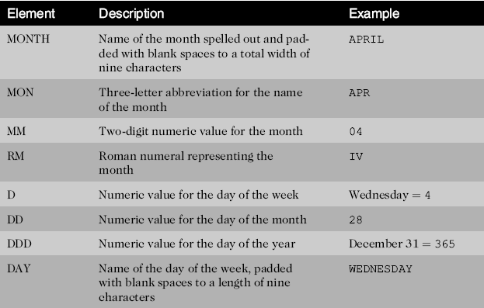
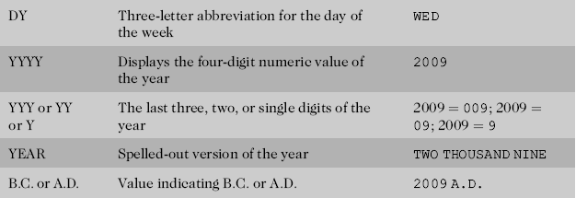
Format Model Elements - Dates
Oracle 12c: SQL
Notes:
A.D. Anno Domini – in the year of our Lord
BC – Before Christ

Slide 24
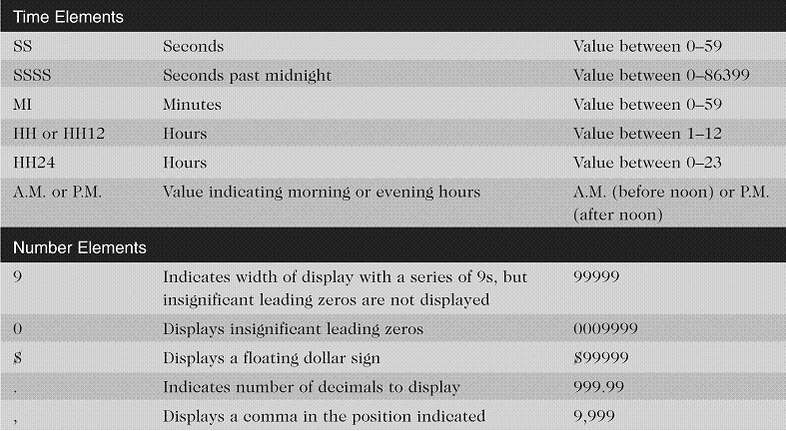
TO_CHAR Format Model Elements
Oracle 12c: SQL

Slide 25
Formatting numbers using TO_CHAR
You can also use TO_CHAR to format output numeric columns; however, it is more common to use SQL*PLUS COLUMN command to format columns.
Show the retail price of all books including the GST (5% tax). Display with 2 digits of precision.
select title, to_char(retail*1.05, '$9,990.00') "Price w GST"
from books;

Slide 26
SOUNDEX Function
Returns the phonetic representation of words
Find all names that sound like Becka.
select firstname, lastname
from customers
where soundex(firstname) = soundex('Beka');
Oracle 12c: SQL

Slide 27
Numeric Functions
Allow for manipulation of numeric data
ROUND
TRUNC
MOD
ABS
TO_NUMBER
Oracle 12c: SQL

Slide 28
ROUND Function
Used to round numeric columns to a stated precision.
Calculate the book price with GST, rounded to two digits of precision.
Modify the following query:
SELECT title, retail*1.05
FROM books;
select title, round(retail*1.05, 2) "Price w GST"
from books;
Oracle 12c: SQL

Slide 29
TRUNC Function
Used to truncate a numeric value to a specific precision
Show the cost price of each book rounded down (truncated) to an integer value.
select title, trunc(cost, 0) "Cost Price"
from books;
Oracle 12c: SQL

Slide 30
MOD Function
Returns the reminder from a division.
Given there is a maximum of 4 books per box and there are 23 books to be delivered, how many full boxes will be needed? How many books will be left over for the final box?
Here we use the dummy table called ‘dual’ to do the calculations, the ‘dual’ table as a single row in it.
select trunc(23/4) "Full Boxes", mod(23,4) "Leftovers"
from dual;
Oracle 12c: SQL

Slide 31
ABS Function
ABS returns the absolute value of a numeric expression.
What is the difference between the cost price and the average cost price of all books ($24.93) ?
select title, cost, abs(cost – 24.93) "Difference"
from books;
Oracle 12c: SQL

Slide 32
TO_NUMBER Function
To convert character string to a number so that math can be performed.
How many years old are the computer books in the bookstore?
select title, 2023 – to_number(to_char(pubdate, 'yyyy'))
"Years Old"
from books
where category = 'COMPUTER';
Oracle 12c: SQL

Slide 33
DUAL Table
Dummy table
Consists of one column and one row
Can be used for table reference in the FROM clause
Oracle 12c: SQL

Slide 34
Using the DUAL table
Use to_char() to extract the current date/time from the pseudo-column SYSDATE using the dual table.
select to_char(sysdate, 'fxDD MON YYYY, HH:MI.SS AM') "System Time"
from dual;

Slide 35
Dealing with Dates

Slide 36
Manipulating Dates
Used to perform date calculations or format date values
Subtract dates to determine number of days difference.
Tomorrow (1 day forward): SYSDATE + 1
Yesterday (1 day back): SYSDATE – 1
One hour forward (1/24 forward): SYSDATE + 1/24
Show all orders, order date, ship date and number of days before the order was shipped.
select order#, shipdate, orderdate, shipdate-orderdate "Days till shipped"
from orders;
Oracle 12c: SQL

Slide 37
MONTHS_BETWEEN Function
Determines the number of months between two dates.
For each book order (title and order#) show the publication date, order date and how many years old the book was when it was ordered.
select title, order#, orderdate, pubdate,
months_between(orderdate, pubdate) / 12 "Years Old"
from books join orderitems using (isbn)
join orders using (order#);
Oracle 12c: SQL

Slide 38
ADD_MONTHS Function
Adds a specified number of months to a date
Publication arrangements on books need to be renegotiated every 20 years. Show title, publication date and renegotiation date for each book along with the name of the publisher.
column "Renegotiation Date" format a20
select title, name, pubdate,
add_months(pubdate, 20*12) " Renegotiation Date"
from books join publisher using (pubid);
clear columns
Oracle 12c: SQL

Slide 39
NEXT_DAY Function
Determines the next occurrence of a specified day of the week after a given date
Orders are typically picked over the weekend and shipped out on the next Monday. Find the expected shipping date for order#1018.
select order#, orderdate,
next_day(orderdate, 'MONDAY') "Est Ship Date"
from orders
where order# = 1018;
Oracle 12c: SQL

Slide 40
TO_DATE Function
Converts various date formats to the internal format (DD-MON-YY) used by Oracle 12c.
Show all order# shipped after a date input by the user. Enter the date as the Month dd, yyyy format
select order#, shipdate
from orders
where shipdate > to_date('&shipDate', 'fmMonth dd, yyyy');
Oracle 12c: SQL

Slide 41
ROUND Function
ROUND can also be used to round dates.
Show the publication date for each book rounded to the closest month.
select title, pubdate,
round(pubdate, 'MONTH') "Rounded Pub Date"
from books;
Oracle 12c: SQL

Slide 42
TRUNC Function Date truncation
Show all books and their publication date. Truncate the publication date to the year it was published.
select title, pubdate, trunc(pubdate, 'YY')
from books;

Slide 43
NULL value functions

Slide 44
NVL Function
Substitutes a value for a NULL value
Show all books, their retail price, discount and new sale price. Substitute in a discount of $0 if a book has no discount. Modify the following query so that ALL books have a final price.
SELECT title, retail, discount, retail-discount "Sale Price"
FROM books;
select title, retail, discount, retail – nvl(discount, 0) "Sale Price"
from books;
Oracle 12c: SQL
Notes:
NVL(a, b)
if (a == null)
return b
else
return a
endif

Slide 45
NVL2 Function
Allows different actions based on whether a value is NULL or not.
Show all orders. If there is a ship date indicate that the order as “Shipped”; otherwise, indicate that the order as “Not Shipped”. Include order#, order date, shipping date and shipping status.
select order#, orderdate, shipdate,
nvl2(shipdate, 'Shipped', 'Not Shipped') "Status"
from orders;
Oracle 12c: SQL
Notes:
nvl2(a,b,c)
if a != null
return b
else
return c
endif

Slide 46
NULLIF Function
NULLIF compares expr1 and expr2 . If they are equal, then the function returns null. If they are not equal, then the function returns expr1.
The orderitems table contains the actual price paid on a specific order (paideach), because of discounts and sales the ‘paideach’ price may be different than the retail price for a book.
Oracle 12c: SQL
Notes:
NULLIF(a,b)
if (a==b)
return null
else
return a
endif

Slide 47
NULLIF
Given an order show all individual items. Sometimes books are sold at a discount and this is recorded in the paideach column of an individual orderitem. Show the order#, item#, book title, retail price and then the discounted price (if appropriate). If the paideach is the same as the retail price show nothing in the discounted price column; otherwise, show the discounted price.
select order#, item#, retail,
nullif(paideach, retail) "Discounted Price"
from books natural join orderitems;

Slide 48
Branching Related Functions

Slide 49
DECODE Function
Determines action based upon values in a list
DECODE (a, value1, return1,
value2, return2, returnDefault)
Oracle 12c: SQL

Slide 50
Tax rates solved with decode
Given the following state tax rates, show each customer name and their applicable tax rate.
CA 6.5%
FL 7%
NJ 7%
TX 6.25
select firstname, lastname, state,
decode(state, 'CA', 6.5, 'FL', 7, 'NJ', 7, 'TX', 6.25, 0) "Sales Tax %"
from customers;

Slide 51
CASE Statement
Two versions
For exact matches:
CASE colName WHEN value1 THEN return1 WHEN value2 THEN return2 ELSE returnDefault END
For relational expressions
CASE WHEN expr1 THEN return1 WHEN expr2 THEN return2 ELSE returnDefault END
Oracle 12c: SQL

Slide 52
Exact match CASE example
Given the following state tax rates, show each customer name and their applicable tax rate.
CA 6.5%
FL 7%
NJ 7%
TX 6.25
select firstname, lastname, state,
case state when 'CA' then 6.5
when 'FL' then 7.0
when 'NJ' then 7.0
when 'TX' then 6.25
else 0.0 end "Sales Tax %"
from customers;

Slide 53
Relational CASE Statement
Rewrite using the relation CASE syntax:
CASE WHEN expr1 THEN return1 WHEN expr2 THEN return2 ELSE returnDefault END
select firstname, lastname, state,
case when state = 'CA' then 6.5
when state in ('FL', 'NJ') then 7.0
when state = 'TX' then 6.25
else 0.0 end "Sales Tax %"
from customers;

Slide 54
Summary
Single-row functions return a result for each row or record processed
Case conversion functions such as UPPER, LOWER, and INITCAP can be used to alter the case of character strings
Character manipulation functions can be used to extract substrings (portions of a string), identify the position of a substring in a string, replace occurrences of a string with another string, determine the length of a character string, and trim spaces or characters from strings
Nesting one function within another allows multiple operations to be performed on data
©2016. Cengage Learning. All rights reserved.

Slide 55
Summary (continued)
Simple number functions such as ROUND and TRUNC can round or truncate a number on both the left and right side of a decimal
The MOD function is used to return the remainder of a division operation
Date functions can be used to perform calculations with dates or to change the format of dates entered by a user
Regular expressions enable complex pattern matching operations
The NVL, NVL2, and NULLIF functions are used to address problems encountered with NULL values
©2016. Cengage Learning. All rights reserved.

Slide 56
Summary (continued)
The TO_CHAR function lets a user present numeric data and dates in a specific format
The DECODE function allows an action to be taken to be determined by a specific value
The searched CASE expression enables you to evaluate conditions to determine the resulting value
The SOUNDEX function looks for records based on the phonetic representation of characters
The DUAL table can be helpful when testing functions
©2016. Cengage Learning. All rights reserved.

